Slide 1

Enzymatic Processes in Industrial Production & its Application
Avni Ajay Sharma
D - 22

Slide 2
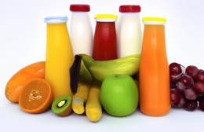
Pectinase: Role
Pectinase is a group of enzymes that breaks down pectin (polysaccharide found in plant cell walls and often fruits too).
Pectin is the jelly-like substance which helps cement plant cells together in which other cell wall components are embedded.
Therefore, pectinase enzymes are commonly used in processes involving the degradation of plant materials, such as speeding up the extraction of fruit juice from fruit. Pectinases have also been used in wine production.
Pectinases can be extracted from fungi. The fungus produces
these enzymes so that it can extract nutrients from the plant
tissues and insert fungal hyphae.

Slide 3
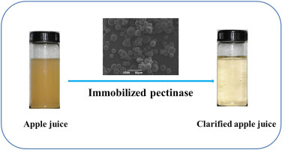
Pectinase: Process Conditions
Pectinases have an optimum temperature and PH at which they are most active.
A commercial pectinase might typically be activated at 45 to 55 °C and work well at a pH of 3.0 to 6.5.
If pectinase is boiled, it is denatured making it harder to connect with the pectin at the active site, and produce as much juice.
Fungal pectinases: Acidic PH (3.5-5.5) & temperature between 30-50°C.
Bacterial pectinases: Neutral to alkaline (PH 7.0-9.0) & temperatures ranging from 37-60°C.
Yeast pectinases: Slightly acidic conditions (PH 4.5-6.0) and moderate temperatures 25-40°C.

Slide 4
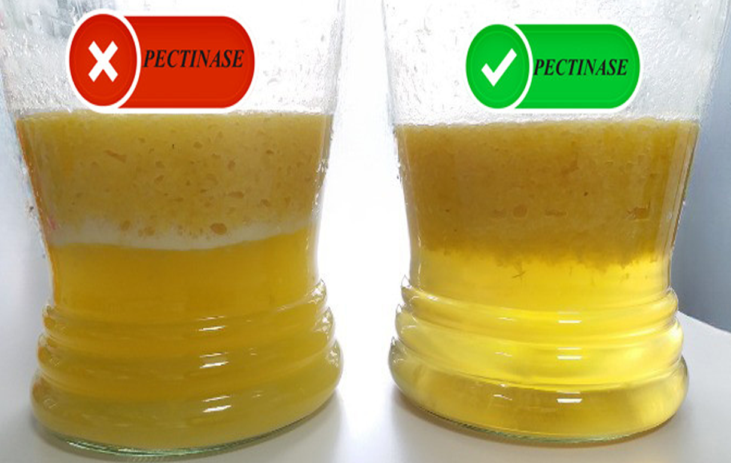
Pectinase: Industrial Application
Pectinase plays a vital role in the food and beverage industry
They are used for the clarification of fruit juices and the speed up of fruit juice extraction through enzymatic liquification of fruit pulp.
This is done when the enzyme pectinase breaks down the substrate pectin and the juice is extracted.
In addition to enhancing juice yield and clarity, pectinase also aids in the extraction of more flavor and color from the fruit pulp, thereby improving the overall quality of the juice.
Temperature: 45–50 °C
pH Range: 3.0 – 5.5 pH
Clarification

Slide 5
PROCESS:
Fruit Juice Production
Fresh Fruit
Crushing / Pulping
Enzyme (Pectinase)
Juice Extraction
Adjusting Optimum Conditions
Clarification

Slide 6

If I were a software engineer….
I would build such a software or a tool that could help in increasing the enzyme efficiency and reliability.
Automatic Monitoring System
I would design this software in such a way that it:
Generates an alarm if any emergencies
Acts like a sensor
Stores day to day data
Notes the number of fruits getting wasted to avoid damages in future

Slide 7
REFERENCES
INFORMATION:
https://en.wikipedia.org/wiki/Pectinase
https://foodsafety.institute/food-biotechnology/pectinase-enzymes-sources-properties-uses/
IMAGES:
https://sparetailer.com/wp-content/uploads/2018/02/EnzymeHero-scaled.jpg
https://www.shutterstock.com/image-photo/fruit-juices-important-component-human-260nw-2371676815.jpg
https://blogger.googleusercontent.com/img/b/R29vZ2xl/AVvXsEhs4RMjRWMFXeLVFCJVX6F8yPsM2y_FnSqdUXeSCvr1lBzC6D2KGtPTBu3wxyaZtZu1QowkrjhmsLYYj7jPoaJpSNNn3MJCyajoAIVJHI4z025ETyFNsqyU9mhbFpIPDiUlmW3pLSpeGDg2/s376/juice+after+clarifying.jpg
http://clipart-library.com/images/8c65B5bzi.jpg

Slide 8
THANK YOU!

